Slide 1
Final Report of Capstone Project
Finding a Better Place in Scarborough, Toronto

Slide 2
INTRODUCTION
Target audiences and stakeholders: Immigrants
Definition of my Business problem:
Lots of people are migrating to various states of Canada and needed lots of research for good housing prices and acceptable schools for their children. Finally, I will suggest a better neighbourhood in a new city for the people who are shifting there. Sorted list of house in terms of housing prices in a ascending or descending order. Sorted list of schools in terms of location, fees, rating and reviews.
This project is for those people who are looking for better neighborhoods. For ease of accessing to Cafe, School, Super market, medical shops, grocery shops, mall, theatre, hospital, like minded people, etc.

Slide 3
The purpose of this Project:
create an analysis of features for a people migrating to Scarborough to search a best neighbourhood as a comparative analysis between neighbourhoods. It will help people in exploring better facilities around their neighbourhood and making smart and efficient decision on selecting great neighbourhood out of numbers of other neighbourhoods in Scarborough, Toronto.

Slide 4
Data Link: https://en.wikipedia.org/wiki/List_of_postal_codes_of_Canada:_M
In order to gain that information we will use "Foursquare" location information. Such information includes venue names, locations, menus and even photos. All the stated required information can be obtained through the API. For each neighbourhood, we have chosen the radius to be 100 meter.

Slide 5
The information obtained per venue includes:
Neighbourhood
Neighbourhood Latitude
Neighbourhood Longitude
Venue
Name of the venue e.g. the name of a store or restaurant
Venue Latitude
Venue Longitude
Venue Category

Slide 6
Methodology
Clustering Approach: To compare the similarities of two cities, we decided to explore neighborhoods, segment them, and group them into clusters to find similar neighborhoods in a big city like New York and Toronto. To be able to do that, we need to cluster data which is a form of unsupervised machine learning: k-means clustering algorithm.

Slide 7
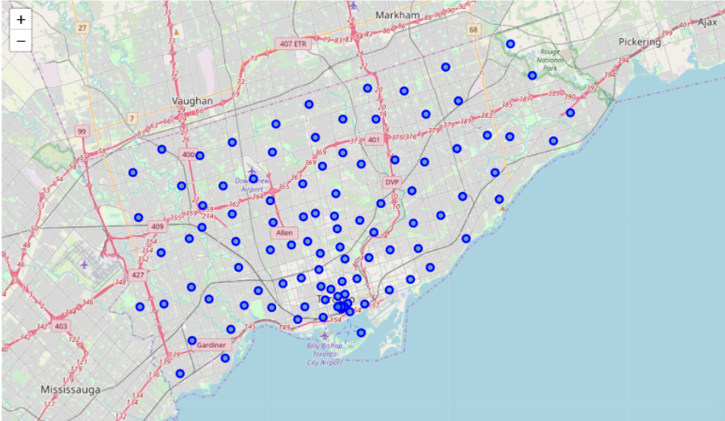
Map of Scarborough

Slide 8
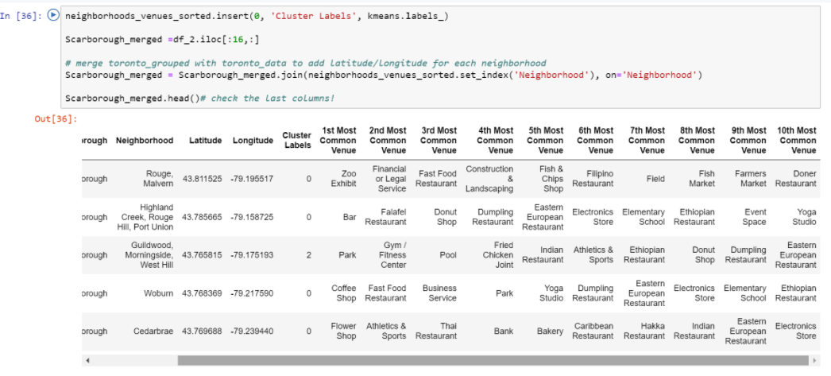
Using K-Means Clustering Approach

Slide 9
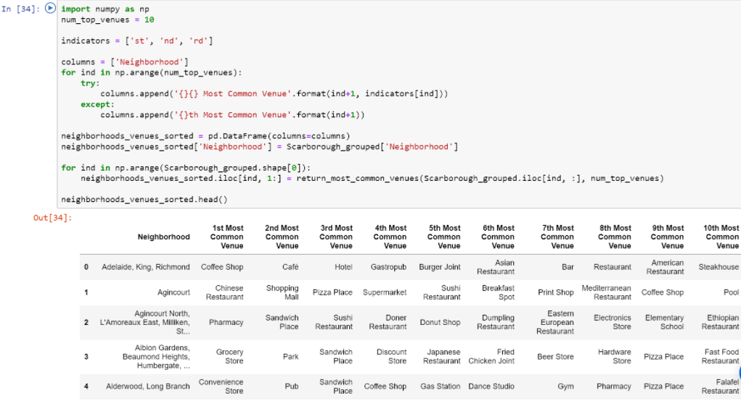
Most Common venues near Neighborhood

Slide 10
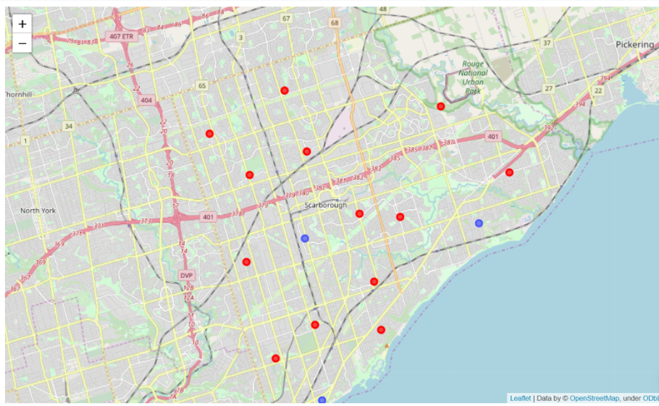
Results
Map of Clusters in Scarborough

Slide 11
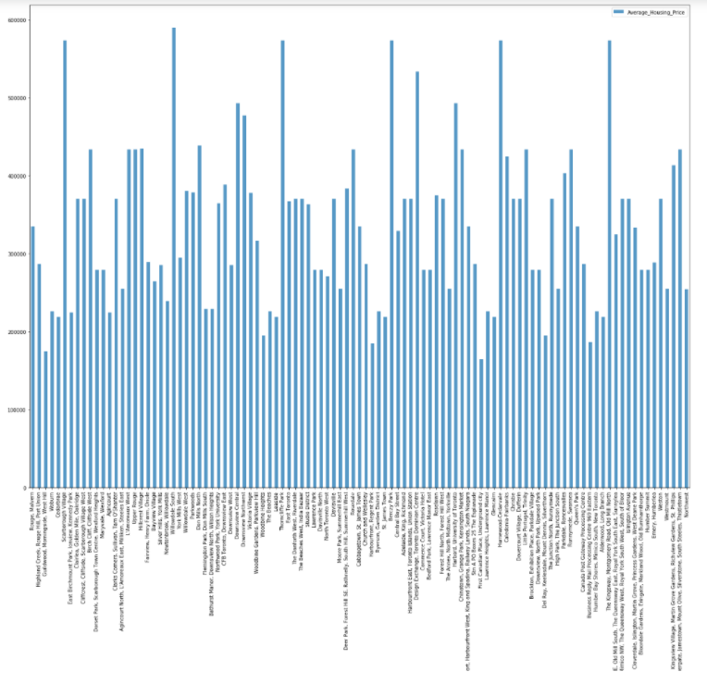
Average Housing Price by Clusters in Scarborough

Slide 12
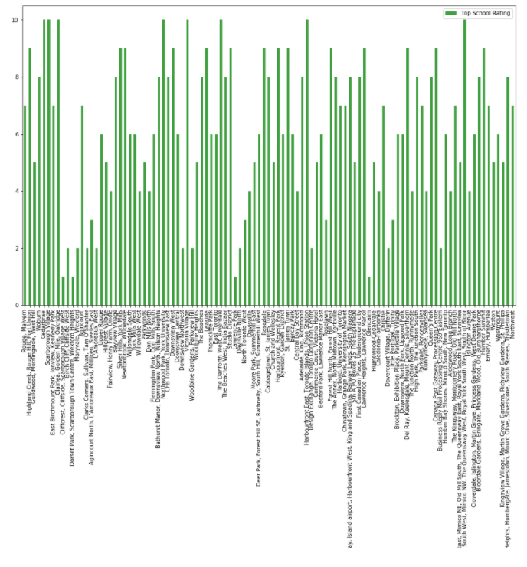
School Ratings by Clusters in Scarborough

Slide 13
Work Flow:
Using credentials of Foursquare API features of near-by places of the neighborhoods would be mined. Due to http request limitations the number of places per neighborhood parameter would reasonably be set to 100 and the radius parameter would be set to 500.

Slide 14
The Location:
Scarborough is a popular destination for new immigrants in Canada to reside. As a result, it is one of the most diverse and multicultural areas in the Greater Toronto Area, being home to various religious groups and places of worship. Although immigration has become a hot topic over the past few years with more governments seeking more restrictions on immigrants and refugees, the general trend of immigration into Canada has been one of on the rise.

Slide 15
Foursquare API:
This project have used Four-square API as its prime data gathering source as it has a database of millions of places, especially their places API which provides the ability to perform location search, location sharing and details about a business.

Slide 16
Conclusion
In this project, using k-means cluster algorithm I separated the neighborhood into 10(Ten) different clusters and for 103 different lattitude and logitude from dataset, which have very-similar neighborhoods around them. Using the charts above results presented to a particular neighborhood based on average house prices and school rating have been made.
I feel rewarded with the efforts and believe this course with all the topics covered is well worthy of appreciation. This project has shown me a practical application to resolve a real situation that has impacting personal and financial impact using Data Science tools. The mapping with Folium is a very powerful technique to consolidate information and make the analysis and decision better with confidence.

Slide 17
Libraries Which are Used to Develope the Project:
Pandas: For creating and manipulating dataframes.
Folium: Python visualization library would be used to visualize the neighborhoods cluster distribution of using interactive leaflet map.
Scikit Learn: For importing k-means clustering.
JSON: Library to handle JSON files.
XML: To separate data from presentation and XML stores data in plain text format.
Geocoder: To retrieve Location Data.
Beautiful Soup and Requests: To scrap and library to handle http requests.
Matplotlib: Python Plotting Module.

Slide 18
Thanks for your listening

